Slide 1
#GlobalAzure
#CloudGenVerona

Slide 2
Produttività con Microsoft Teams

Slide 3

Who I am
@signorellidenis
https://github.com/SignorelliDenis
Denis Signorelli
https://www.linkedin.com/in/denisignorelli/

Slide 4


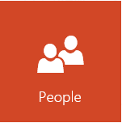
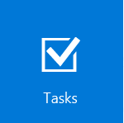
Agenda
Overview su Microsoft Teams;
Office 365 Groups;
Come essere produttivi con Teams;
Compliance;
Demo;
Q&A.
Notes:
What is a Microsoft Team?

Slide 5
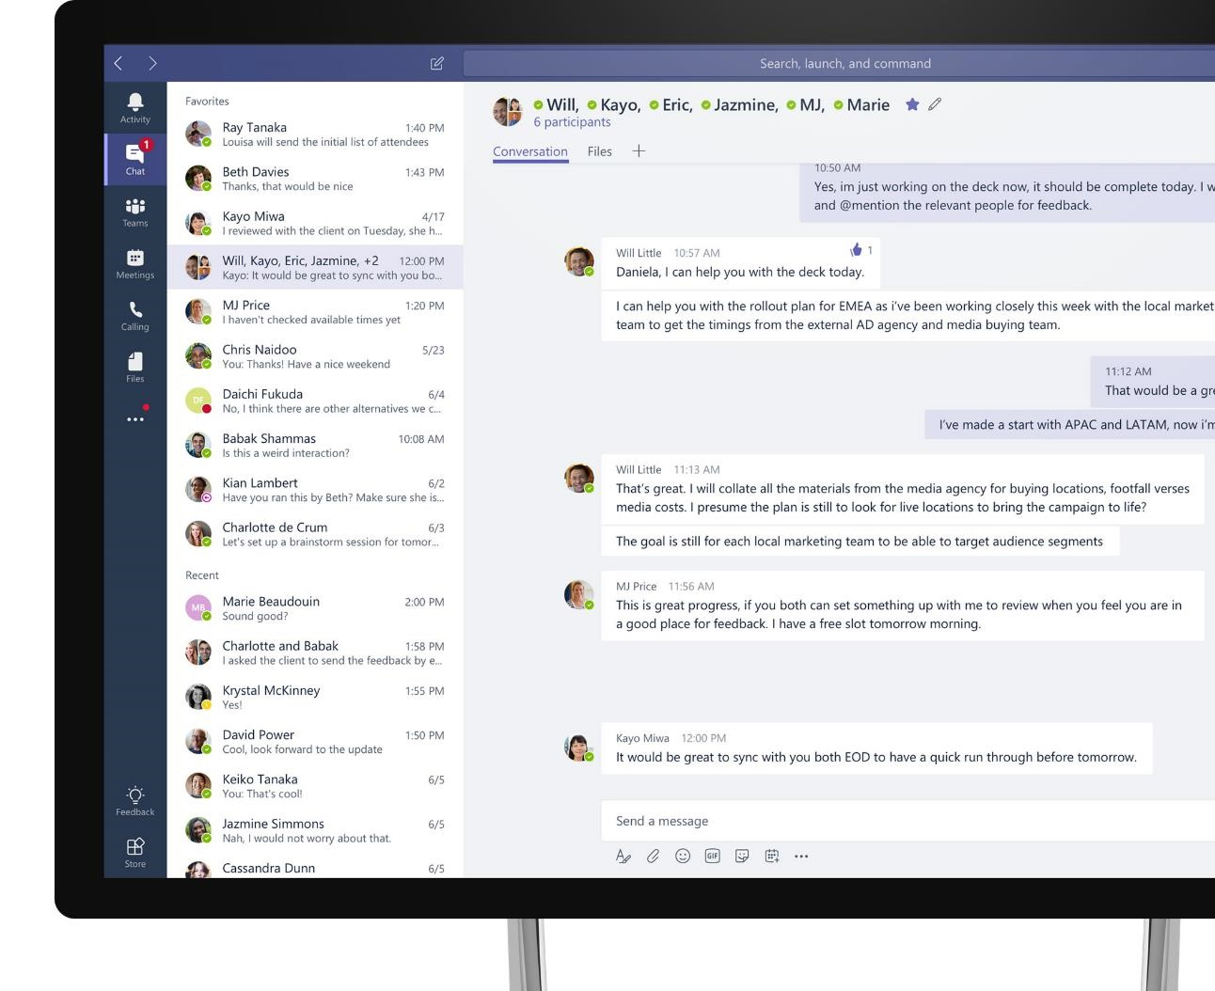
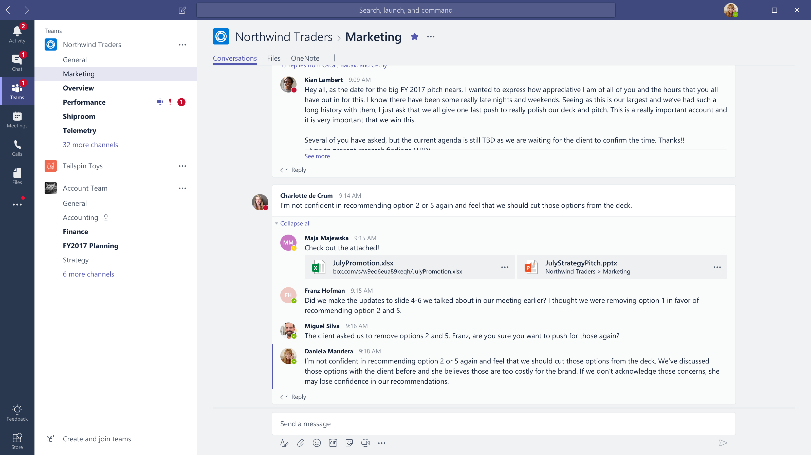



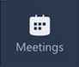


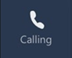



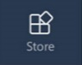
Microsoft Teams
The hub for teamwork in Microsoft 365
Communicate
through chat, meetings & calls
Collaborate
with deeply integrated Office 365 apps
Customize & extend
with 3rd party apps, processes, and devices
Work with confidence
enterprise level security, compliance, and manageability

Slide 6







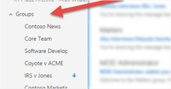
Quando fai la creazione di un Team:
- Un nuovo Office 365 Group;
- Un sito ed una libreria su SharePoint Online per mantenimento dei file del team;
- Una casella di posta condivisa su Exchange Online ed un calendario condiviso;
- Un notebook su OneNote;
- Links col altri apps di Office 365 come Planner e Power BI.
Come mai i gruppi non appariscono più su Outlook?
Set-UnifiedGroup -Identity Team1 -HiddenFromExchangeClientsEnabled:$True

Slide 7
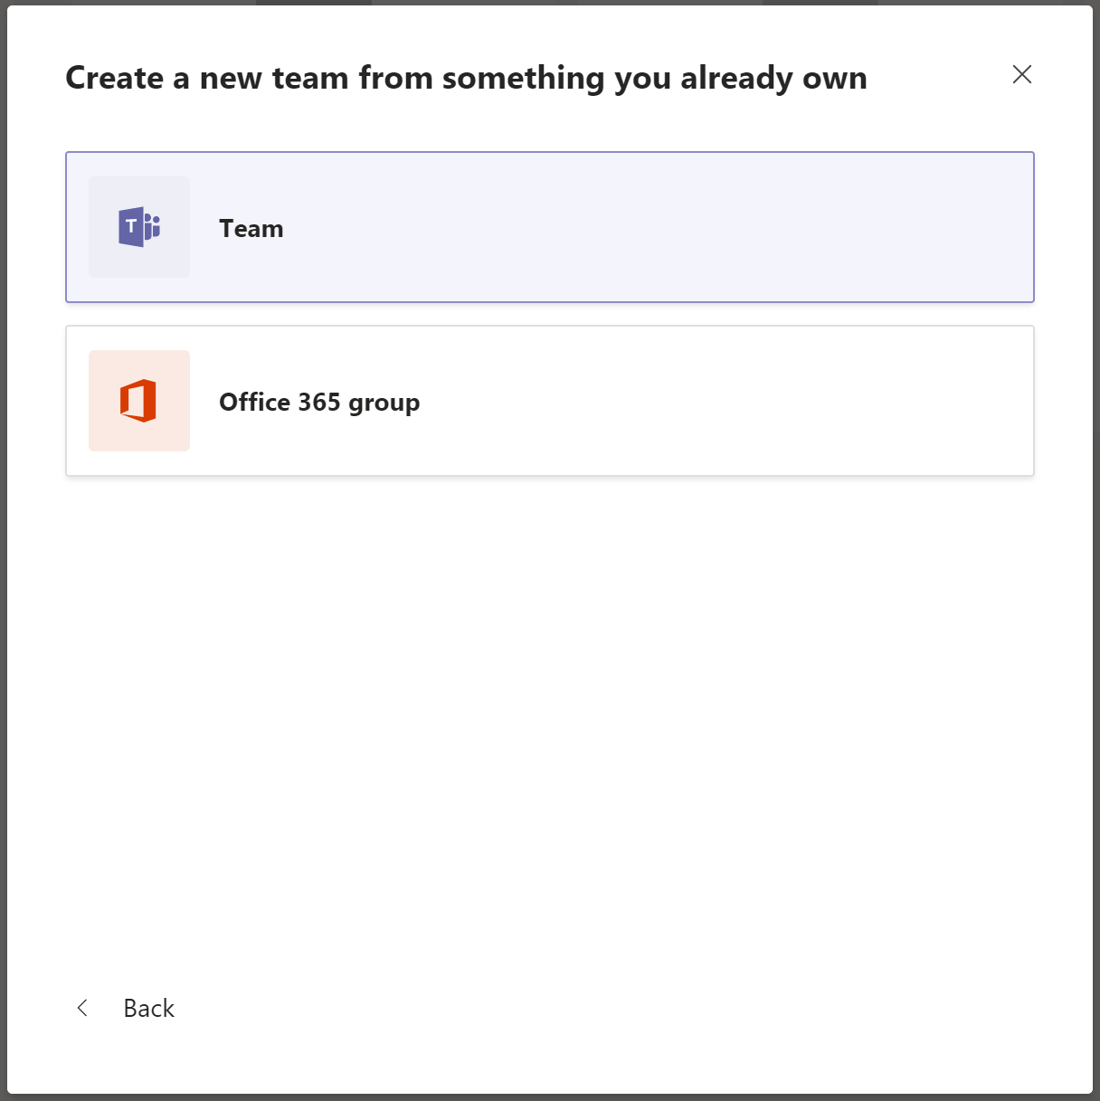
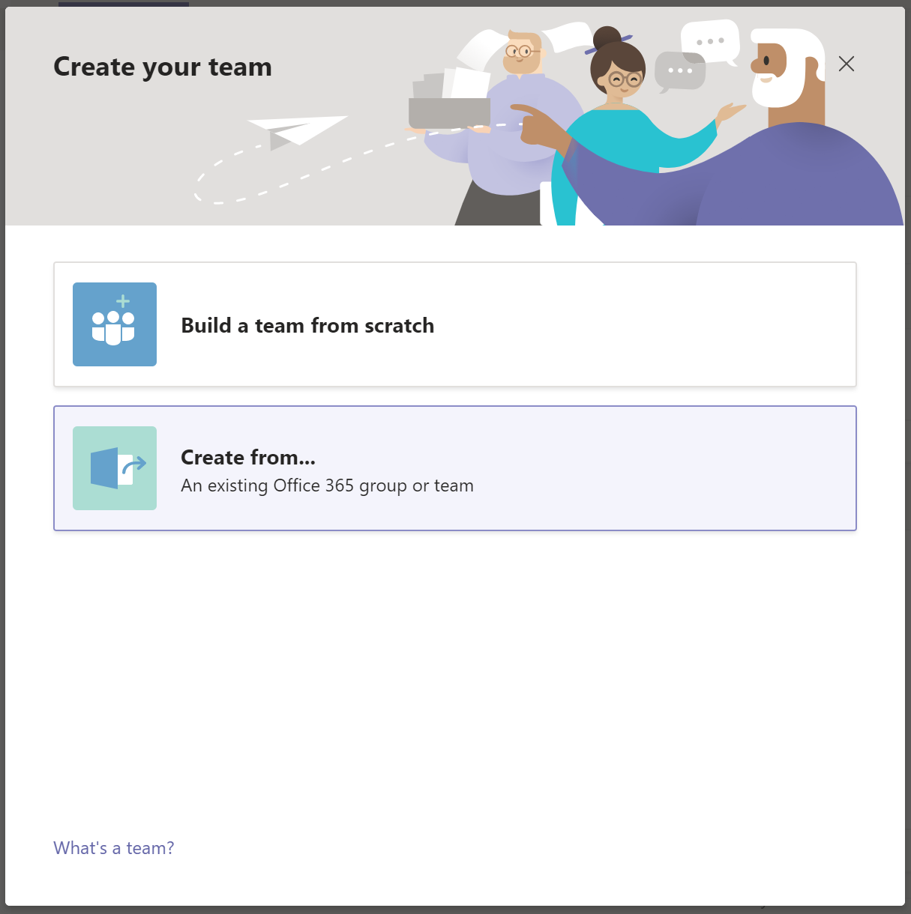
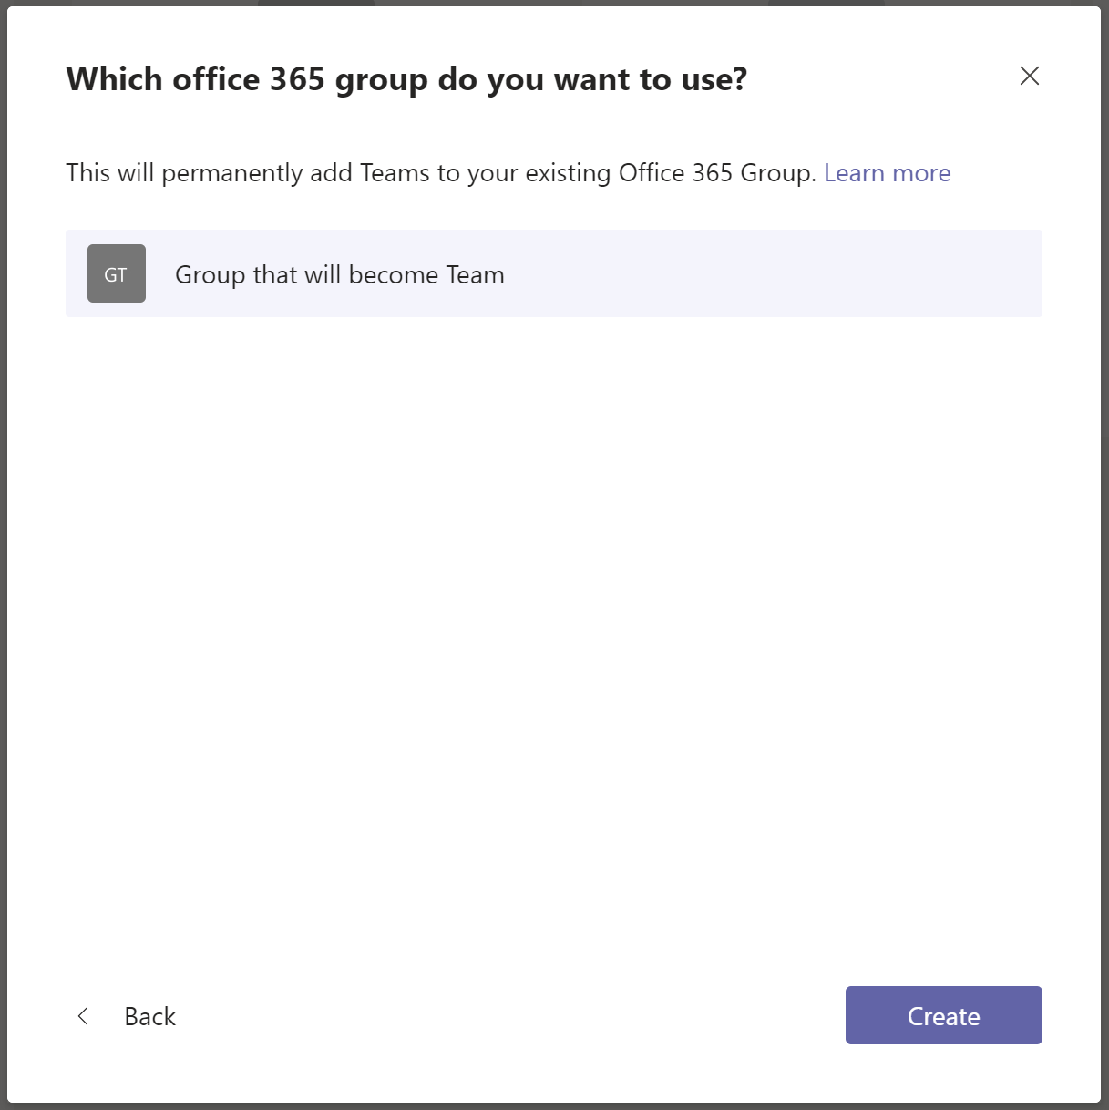
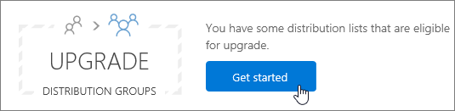
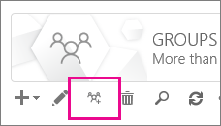
Usando impostazione previa
Microsoft Teams
Exchange Online
Notes:
Migrate DL to Office 365 Groups: Only Cloud DLs, cannot be previously synced

Slide 8
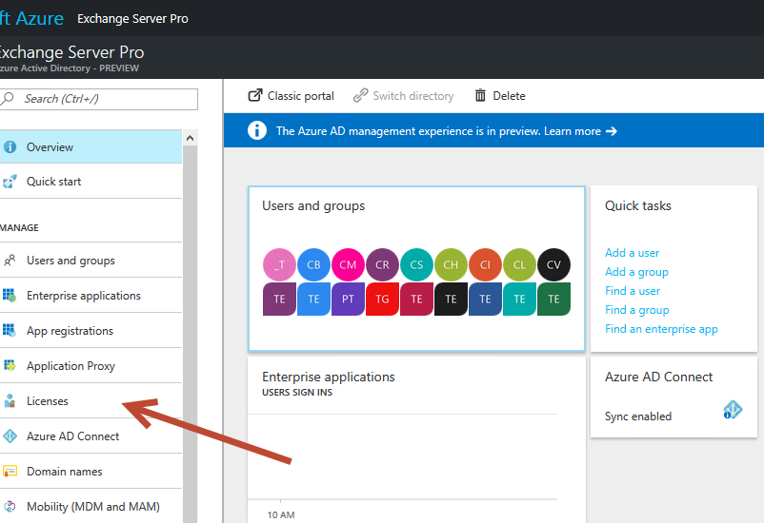
Office 365 Group settings
Tipi: Pubblico, Privato e Dinamico (richiede Azure AD Premium P1)
Amministrazione: Exchange, Admin Center e Azure AD
Naming Policies: Usare “Name convention” per dare nome ai gruppi Azure AD Premium P1
Periodo di retention: 30 giorni (default Tenant)
Ciclo di vita: 180, 365 oppure custom. Avvisi per la rinnovazione 30, 15 e 1 giorno prima dalla scadenza. Richiede Azure AD Premium
Limit Gruppi: 250 per utente, 500k per Tenant
Limit Membri: 5k
Conservazione: 25 TB + 10 GB per utente. Volendo + storage addizionale (SharePoint Online). 50 GB sulla casella di posta.
Notes:
Teams and channels
Number of teams a user can create Subject to a 250 object limit¹
Number of members in a team 5,000
Number of members in an org-wide team 5,000
Number of teams a global admin can create 500,000
Number of teams an Office 365 tenant can have 500,000
Number of channels per team 200 (includes deleted channels)
Meetings and calls
Number of people in a meeting 250
Number of people in a private chat 50

Slide 9

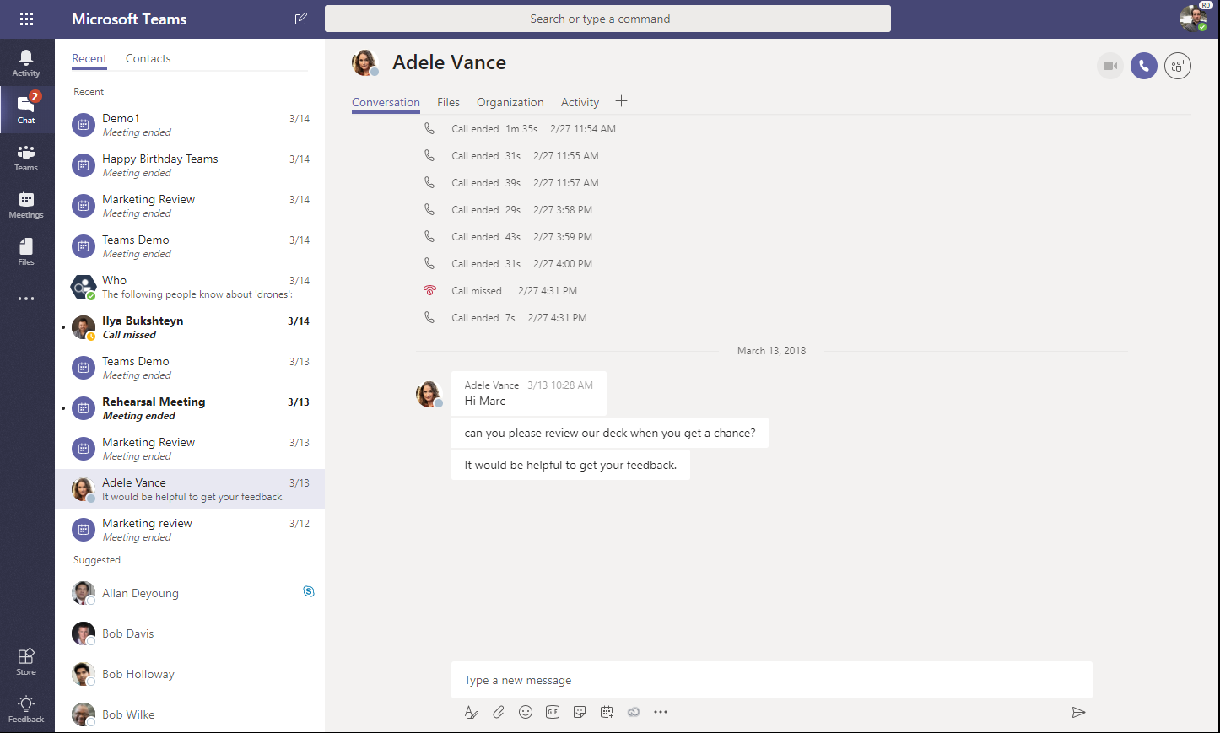
Conversation storage
Dove la chat è mantenuta ?
Chat service
In memory processing for speed
Leverages Azure storage (moving to Cosmos DB)
Exchange
Chat and channel messages are also stored in Exchange for information protection
Conversation images & media
Inline Images/Stickers are stored in a media store, Giphys are not stored.
Notes:
One question that we hear a lot from customers is: Where are chat messages stored?
Since it is persistent chat, it uses its own storage. Today, our chat service uses Azure Storage, but we are moving towards Cosmos DB. This will help us improve reliability and performance.
That data is then journaled into exchange. For example, if I have a group chat with 3 of my colleagues. The messages will be journaled into a hidden folder in my mailbox. Similarly, the messages will be stored in the mailbox of the rest of the participants.
For conversations that take place within a Team, the messages are stored in a group mailbox. This is primarily for compliance reasons, like enforcing information protection.
Any media is stored in a media store, separately.

Slide 10
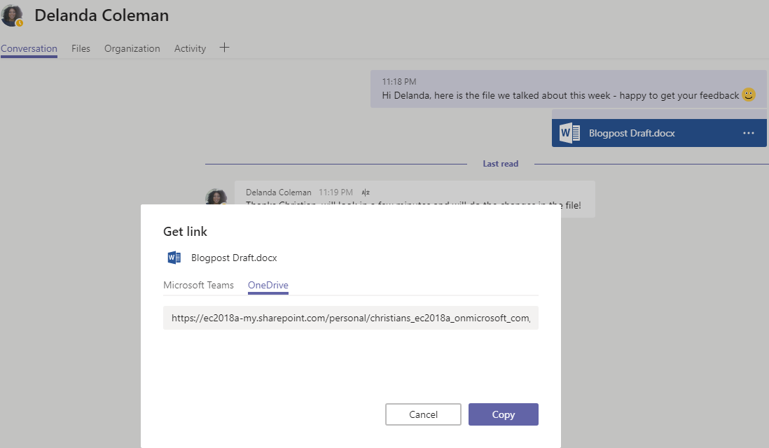
File storage
Dove i file sono mantenuti ?
1:N chats
Files are uploaded to OneDrive for Business and permissions are set for the members of the chat
Team conversations
Files are uploaded to SharePoint. A folder is associated with each channel in the team
Cloud storage
Dropbox, Box, Citrix ShareFile, Google Drive
Notes:
In terms of files, we leverage SharePoint and OneDrive for storage.
If I share a file in a 1:1 or group chat, it gets store in my OneDrive for Business and all participants on that chat are automatically given permission to access it.
Similarly, if you drop a file in a channel, it is stored in the corresponding folder within SharePoint and all members of the Team automatically get the right permissions to access it.
This streamlines collaboration allowing everyone to have access to the information they need without users taking an extra step to grant permissions.
For third party cloud storage, these are default of and as an admin you would have to enable this.

Slide 11
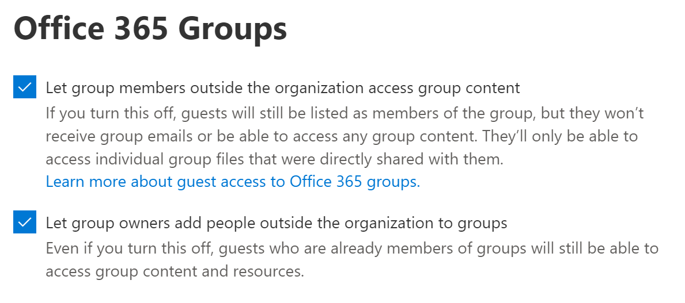
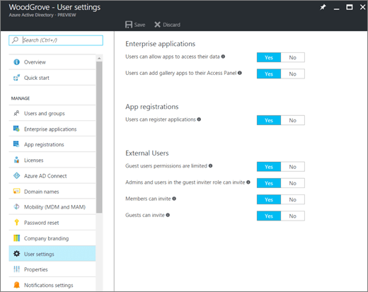
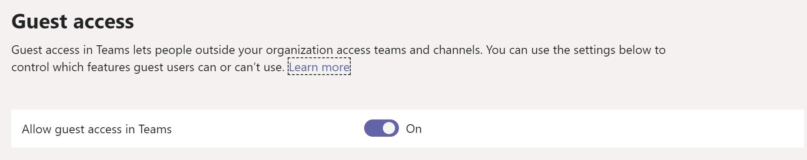
Guest Users
Portal Office 365
Azure AD
Microsoft Teams
Notes:
Authorize guest access in Microsoft Teams
https://docs.microsoft.com/en-us/microsoftteams/teams-dependencies

Slide 12
Guest Users Limits
Incluso su Office 365 Business Premium, Office 365 Enterprise, and Office 365 Education subscriptions;
5 Guest Users per ogni licenza attiva nel Tenant;
Si può usare account di Google, Microsoft Accounts, Yahoo Accounts (Azure B2B);
Volendo, gli utenti guest possono apparire sulla lista di indirizzi globale (GAL);
Non possono creare nuovi Team, non possono aggiungere Apps;
Non possono condividere file tramite Chat (P2P), perché non hanno OneDrive for Business;
Non hanno calendar;
Notes:
Guest capabilities in Teams
https://support.office.com/en-us/article/guest-capabilities-in-teams-d03fdf5b-1a6e-48e4-8e07-b13e1350ec7b
What is guest user access in Azure Active Directory B2B?
https://docs.microsoft.com/en-us/azure/active-directory/b2b/what-is-b2b

Slide 13
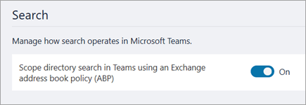
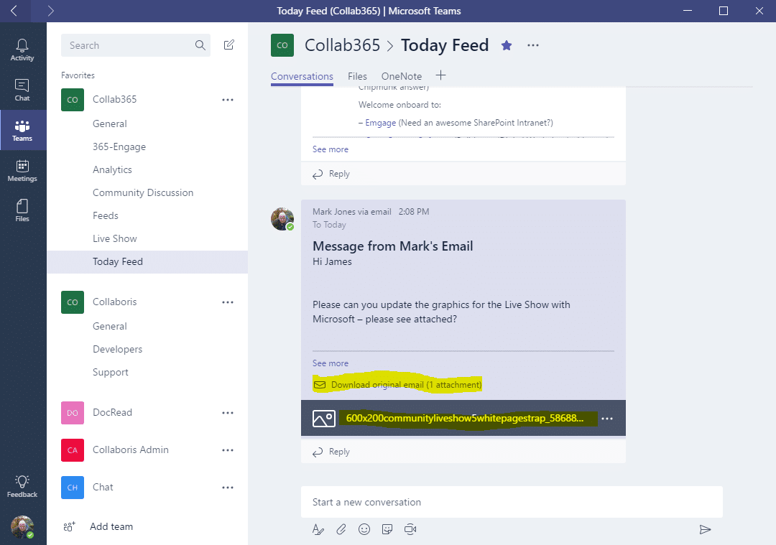
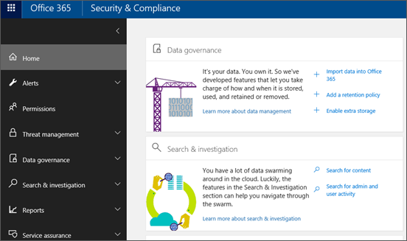
Integrazione con Exchange
Lista dei contati personalizzata
Mail in formato HTML
Security Compliance Center
Notes:
Use Microsoft Teams scoped directory search
https://docs.microsoft.com/en-us/MicrosoftTeams/teams-scoped-directory-search
Searching cloud-based mailboxes for on-premises users in Office 365
Send an email to a channel in Teams
The feature is not enabled by your IT admin.
The channel settings restrict who can send email.
The email contains more than 50 inline images.
The email has more than 20 file attachments.
The email has an attachment that's more than 10 MB.

Slide 14
Teams and Exchange on-premises
For the full Microsoft Teams experience, every user should be enabled for Exchange Online, SharePoint Online, OneDrive for Business and Office 365 Group creation.
eDiscovery
(messages, files)
Modify user profile picture
Legal hold
(messages, files)
Retention
(messages, files)
eDiscovery
(calling / meeting)
Team and Channel management
Add and configure connectors
Create and view meetings
Manage contacts
Voicemail
Add and configure bots
Call History
Access Outlook contacts
Add and configure tabs
Exchange Online | ✓ | ✓ | ✓ | ✓ | ✓ | ✓ | ✓ | ✓ | ✓ | ✓ | ✓ | ✓ | ✓ | ✓
Exchange Online Dedicated vNext | ✓ | ✓ | ✓ | ✓ | ✓ | ✓ | ✓ | ✓ | ✓ | ✓ | ✓ | ✓ | ✓ | ✓
Exchange Online Dedicated – Legacy | Yes (must be on allowed list) | ✕ | ✕ | Yes (must be on allowed list) | ✓ | ✕ | ✕ | ✓ | ✓ | ✕ | Yes (Exchange 2013+)* | ✕ | ✓ | ✓
Exchange on-premises | Yes (must be on allowed list) | ✕ | ✕ | Yes (must be on allowed list) | ✓ | Exchange 2016 CU3 or later | ✕ | ✓ | ✓ | ✕ | Yes (Exchange 2013+)* | ✕ | ✓ | ✓
https://docs.microsoft.com/en-us/microsoftteams/exchange-teams-interact

Slide 15
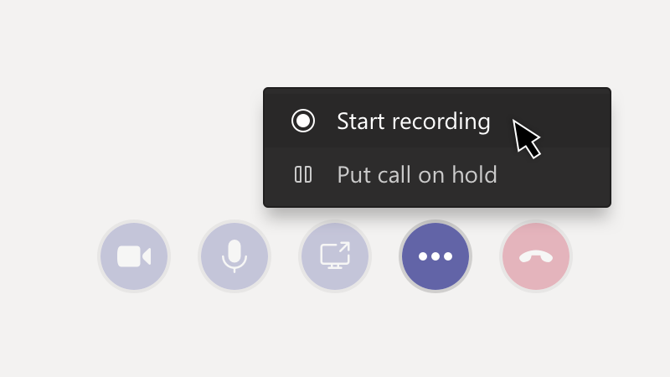
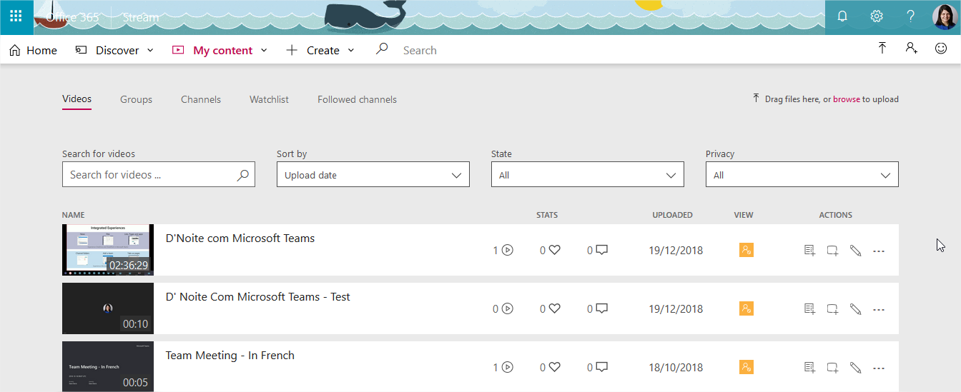

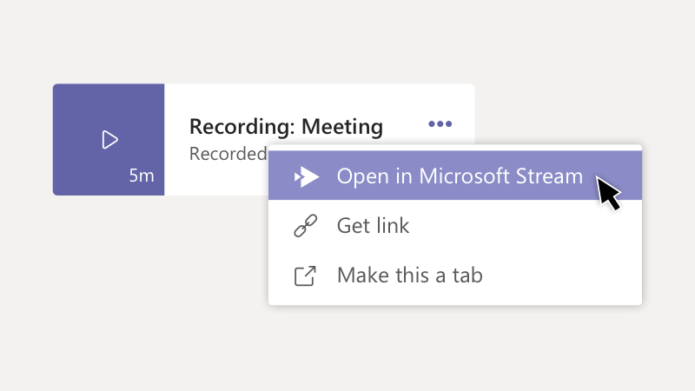
Meeting Record
https://web.microsoftstream.com/studio/videos

Slide 16
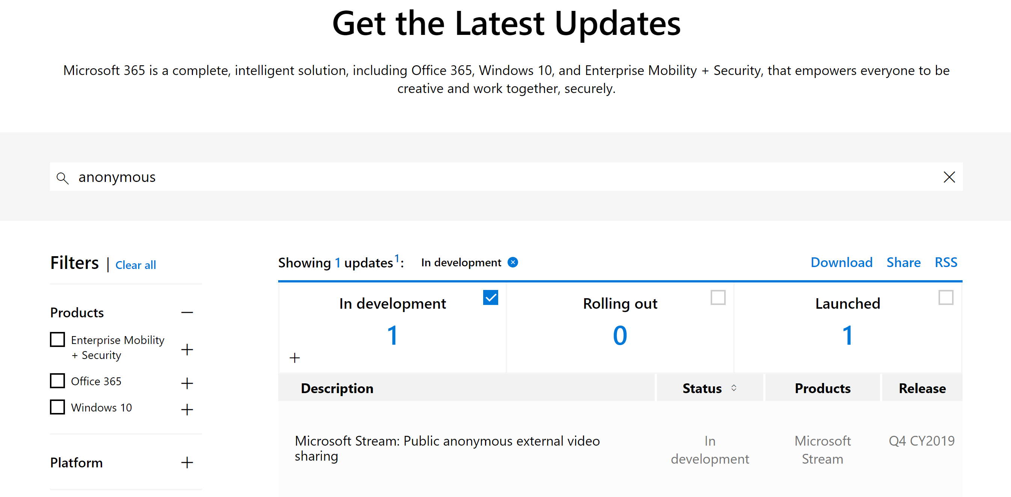
Microsoft 365 Roadmap
https://www.microsoft.com/en-us/microsoft-365/roadmap
Notes:
CY: Calendar Year

Slide 17
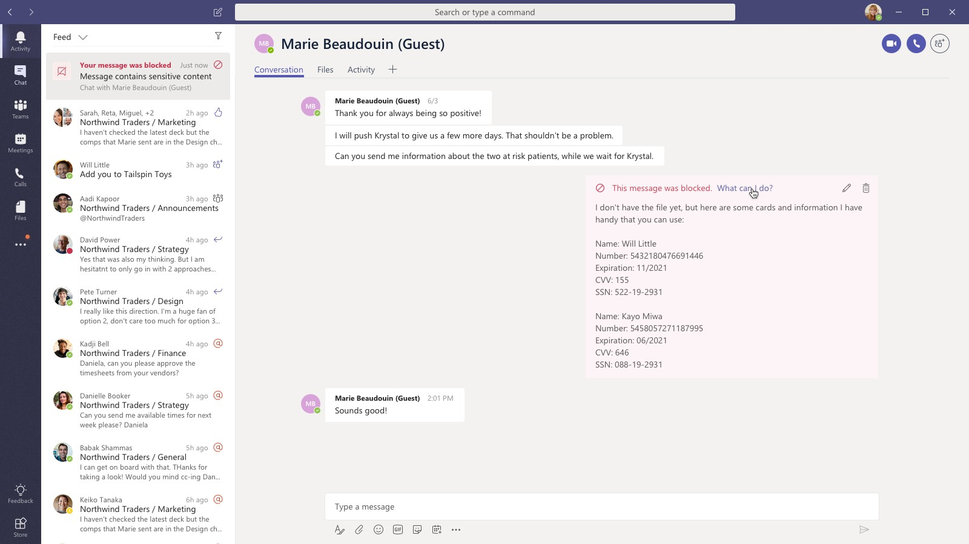
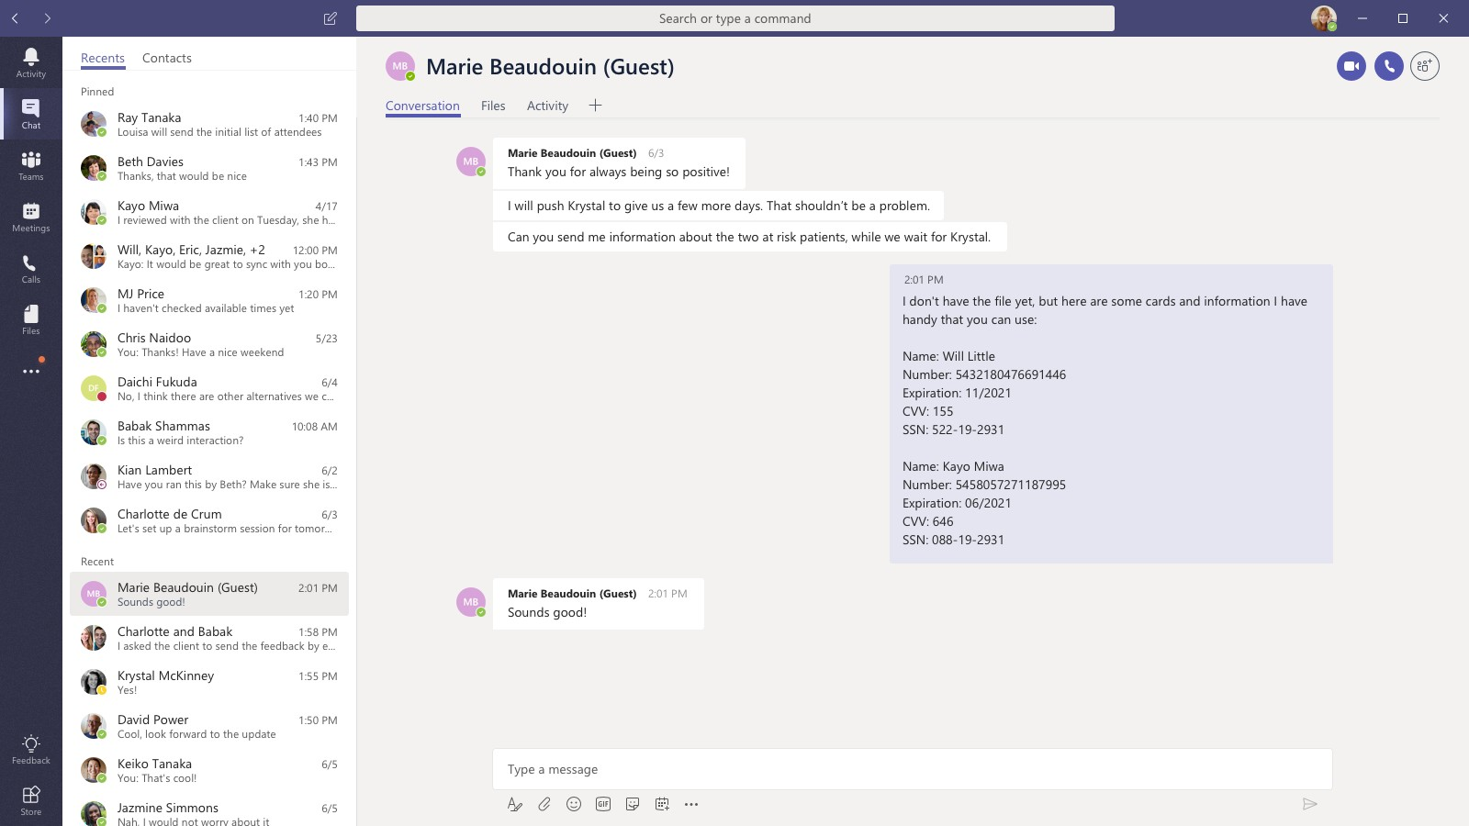
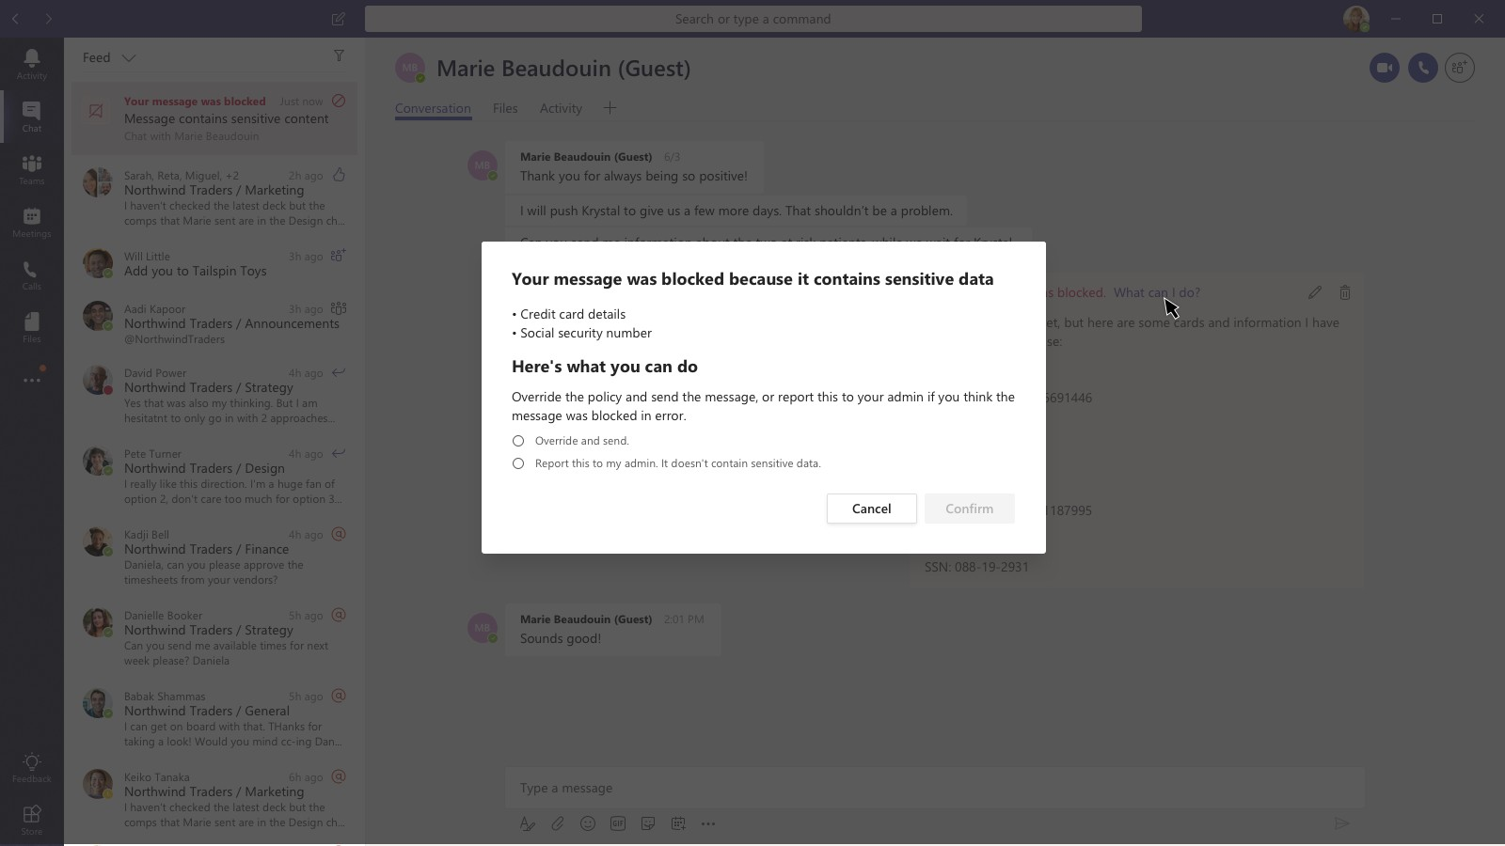
Data Loss Prevention
DLP monitora automaticamente la comunicazione degli utenti per garantire che non condividano erroneamente informazioni riservate.
Health Records
Social Security
Credit Card
Custom definitions
etc.
API disponibili per supportare l'estensibilità DLP di terze parti.

Slide 18


Slide 19

How compliant is Microsoft Teams?
Controls
Microsoft Teams Certification
More than 950 Office 365 controls
Access control
Auditing and logging
Identification and authorization
Awareness and training
Continuity planning
Incident response
Risk assessment
Communication protection
Information integrity
Deployment Approvals and management
Ongoing compliance processes
Recurring audits like SOC, FEDRAMP, ISO+ independent verification
Microsoft Cloud Services Verified with International, Regional and Industry specific standards and terms
Strong Privacy and Security Commitments
ISO 27001
ISO 27018
EU Model Clauses (EUMC)
GDPR
HIPAA Business Associated Agreement
SSAE 16 SOC 1 & SOC 2 Reports
FedRAMP Moderate and High
IRS 1075, UK Official (IL2)
Health Information Trust Alliance (HITRUST)
Contractual commitment to meet US and EU data residency requirements

Slide 20
Demo
Notes:
1: Teams Translator
2: Apertura dei file di stampante 3D e Raggio X

